Slide 1
SmartVoice
RNS INSTITUTE OF TECHNOLOGY BENGALURU – 98 DEPARTMENT OF INFORMATION SCIENCE & ENGINEERING
Presentation on Technical Seminar
Abhaya Simha S P 1RN19IS002
Adithya R Pai 1RN19IS010
Chinmay Hegde 1RN19IS053
Rakshita S 1RN19IS116
Internal Guide
Dr. Mamatha G
Professor
Dept of ISE, RNSIT
Panel Member
Mrs. Vinutha G K
Asst. Prof,
Dept of ISE, RNSIT

Slide 2
Agenda
Abstract
Introduction
Literature Review
Analysis
System Design
Implementation
Testing
Discussion of Results
National Conference Paper
Conclusion and Future Enhancements
References
Q & A

Slide 3
Abstract
Hand gestures play an important role in sign language. The communication of hearing-impaired people with the outside world is challenging. The primary means by which people convey messages with one another is communication.
People who have trouble speaking and hearing, such as "dumb" and "deaf“, find it challenging to understand what the other person is attempting to say.
This project is designed to enable those with special needs to participate equally in society. This project offers a system that will automatically recognize hand movements and translate them into text outputs so that persons with disabilities can readily communicate with healthy individuals.
A webcam system connected to the computer will capture the images of the hand, and contour feature extraction is being used to identify the person's hand gestures.

Slide 4

Introduction
The hand gestures are one of the typical methods used in sign language which can represent ideas using unique shapes and finger orientation have a scope for human machine interaction
Gestures are considered as the most natural expressive way for communications between human and computers in virtual system.

Slide 5
Introduction
The strategy proposed makes utilization of a webcam through which hand gestures given by the user are captured and identified accordingly
Indian Sign Language (ISL) is one of the most difficult subjects since, unlike American Sign Language (ASL), as it is still in the early stages of development. This initiative seeks to aid in the ongoing investigation of this topic by offering an ISL data set.

Slide 6
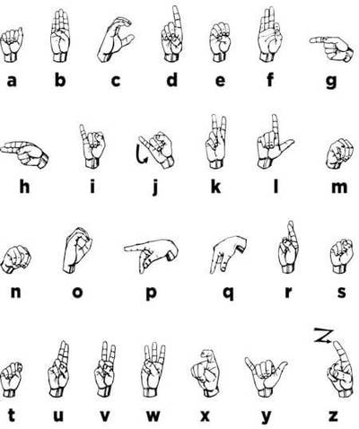
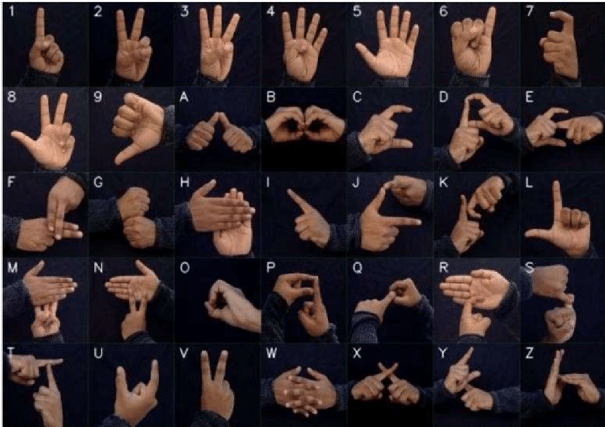
Indian Sign Language
American Sign Language

Slide 7
Literature Review
 | Heading | Year | Author(s) | Abstract | Future enhancements
1 | Hand Gesture Detection and Conversion to Speech and Text | 2018 | K.Manikandan, Ayush Patidar, Pallav Walia, Aneek Barman Roy. | The interface solution's practical adaptability for blind and visually impaired persons is constrained by its simplicity and applicability in real-world situations. | The application can be integrated with other mobile and IoT devices to improve user interaction an d make the system more robust.
2 | Hand Gesture Recognition and Speech Conversion for Deaf and Dumb using Feature Extraction. | 2017 | Rupesh Prajapati, Vedant Pandey, Nupur Jamindar, Neeraj Yadav, Prof. Neelam Phadnis | A system called the Dumb Aid Phone is described in paper[2] as a useful communication tool for the dumb. To ensure optimal accuracy, the system makes use of cutting-edge technology including image processing and the SIFT algorithm. | . Most of the work on intelligent-based sign recognition systems are at the research and prototype stage. Implementation of the proposed model will find practical application to automatic sign language.
3 | Hand Gestures Recognition Conversion to Speech. | 2019 | Amit Kumar, Asraa Ahmad, Anushka Jaiswal, Ananya Kumar | The system explains the structure and operation of a system that helps dumb and deaf people communicate with each other and with other people. This technology translates sign language into voice that can be easily understood by the hearing, dumb, and sighted. | Further study on a non-manual sign involves the face region, including the movement of the head, eye blinking, eyebrow movement, and mouth shape.
4 | Hand Gesture Recognition and Voice Conversion for Deaf and Dumb | 2019 | Amit Kumar , Asraa Ahmad , Anushika Jaiswal, and Ananya Kuma | Image processing was used to recognise hand gestures and convert voices for dumb and deaf people. The technique outputs text and audio after accepting an image as input. This system's implementation provides accuracy of up to 90% and functions well in the majority of test cases. | Analysis can be extended for other country stock study
5 | Hand Gesture Recognition System for Deaf and Dumb | 2020 | Twitter datasets | An effective gesture detection system was created without the usage of cameras or markers, making it more user- and budget-friendly. | Evolutionary models can be used to speed up training

Slide 8
Literature Review
6 | Wearable Sensor-Based Sign Language Recognition | 2021 | Karly Kudrinko, Emile Flavin, Xiaodan Zhu, Qingguo Li | Advancements in technology and machine learning techniques have led to the development of innovative approaches for gesture recognition. This literature review focuses on analyzing studies that use wearable sensor-based systems to classify sign language gestures. | More attention on sentimental analysis for extraction from social media
7 | Using Deep Learning in Sign Language Translation to Text | 2022 | Carl Jose M. Guingab, Ron Andrew Relayo, Mark Joseph C. Sheng, John Ray D. Tamayo | The researchers utilized Convolutional Neural Networks (CNN), Connectionist Temporal Classification (CTC), and Deep Belief Network (DBN) to collect and gather the results of their system through different methods of translating sign language into text. | The study recommends studying further into the less utilized methods in sign language recognition, like DNN and CTC.
8 | A Comprehensive Review of Sign Language Recognition: Different Types, Modalities, and Datasets | 2022 | M. MADHIARASAN, PARTHA PRATIM ROY | This review paper facilitates a comprehensive overview of SLR and discusses the needs, challenges, and problems associated with SLR. We study related works about manual and non-manual, various modalities, and datasets. | SLR model design needs a better understanding of optimal hyperparameter estimation strategy.
9 | Indian Sign Language Recognition Using Machine Learning Techniques | 2021 | Ashok Kumar Sahoo | The system is intended to convert isolated digit signs into text, that is, each entered sign image should contain precisely one numeric sign. | Need to address the recognition of signs with facial expression, hand gestures and body movement simultaneously with the better recognition accuracy in real-time with improved performance. The researchers envisage that these challenges can be achieved using a deep learning approach with a high configuration system to process the input data with low computational time.
10 | Machine learning methods for sign language recognition: A critical review and analysis | 2016 | I.A.Adeyanjua, O.O.Bellob, M.A.Adegboyea | The publication trend in intelligent sign language recognition system is consistent with the rapid increase in people affected by hearing disability. | Different researches have been done on words, alphabets and numbers. However, there is a need for more research in future for sentences recognition in sign language

Slide 9
Literature Review
11 | Sign Language Recognition Systems: A Decade Systematic Literature Review | 2019 | Parteek Bhatia | It provides an academic database of literature between the duration of 2007-2017 and proposes a classification scheme to classify the research articles. Three hundred and ninety six research articles were identified and reviewed for their direct relevance to sign language recognition systems | Futuristic research on sign language recognition can be extended in several directions. Most of the works in sign language recognition have been performed on isolated signs.
12 | Sign language recognition | 2017 | Tülay Karayıla, Özkan Kılıç | a sign language recognition system using Backpropagation Neural Network Algorithm is proposed based on American Sign Language.
13 | A Survey on Sign Language Recognition Systems | 2021 | Shruty M. Tomar, Dr. Narendra M. Patel, Dr. Darshak G. Thakore | These systems can be of great help to dumb people as they can easily communicate with anyone using such system | Non-manual approach could be more effective in recognition as it considers facial expressions along with hand gestures but it can increase the complexity of implementation because variation in facial expression and body language can be much higher compared to variation in just hand gestures of different people.
14 | Hand Gesture to Speech and Text Conversion Device | 2020 | K. P. Vijayakumar, Ananthu Nair, Nishant Tomar | Using the 4 flex sensors, the system responded quickly and effectively to each of the 14 motions that were provided. | The system can be made portable by using the battery or a small solar panel can be used as a power source. The inclusion of multilingual can provide flexibility to the system.
15 | Hand Gesture Recognition: Sign to Voice System S2V | 2008 | Oi Mean Foong, Tan Jung Low, Satrio Wibowo | According to the experimental findings, the system prototype S2V has achieved a satisfactory recognition rate in the automatic conversion of sign language to speech. | For future research, we propose Hidden Markov Model (HMM) to detect longer sequences in large sign vocabularies and shall integrate this technique into a sign-to-voice system, or vice-versa, to help normal people to communicate more effectively with mute or hearing impaired people.

Slide 10
Analysis
Problem Identification
Communication between deaf-dumb and normal person have been always a challenging task. By providing a technique where gestures made by them can be converted to text this can be achieved by capturing an image through a camera.

Slide 11
Analysis
Objectives
Constructing an architecture regarding hand gesture recognition and conversion to text.
Creating an Application that can serve users 24/7 at the endpoint.
Creating an easy monitoring environment to capture hand gestures in improvement of the model.

Slide 12
System Design
The system diagram shows every significant data structure, reporting strategy, yield, and genuine module in the system. Their specifications are chosen. The diagram that demonstrates how to implement the system that is planned in an architectural diagram is called a design diagram.
Images taken from web-camera
Preprocessing of images
Removal of background and objects
Image in binary form
Feature extraction and recognition
Image to text conversion
Matched image
Preimages stored in database

Slide 13
Start
Input Image
Gesture Detection
Gesture Detected?
No
Yes
Image Processing
Trained
Dataset
Feature Extraction
Image Recognition
Result
Stop
The webcam images are acquired, pre-processed, and then the features are retrieved and fed into a classification system, with the expected results.

Slide 14
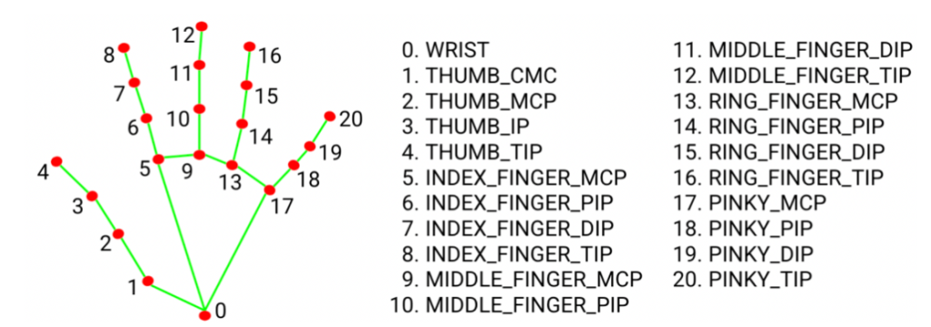
Implementation
Image processing : The MediaPipe Hand Landmarker task detects the landmarks of the hands in an image. This is accomplished by using Skin Masking to define the threshold on the RGB schema and then converting the BGR color space to an RGB image.
Programming Language: Python is an easy to learn, powerful programming language. It has efficient high-level data structures and a simple but effective approach to object-oriented programming.

Slide 15
Implementation
SVM model: Support Vector Machine or SVM is one of the most popular Supervised Learning algorithms, which is used for Classification as well as Regression problems.
TKINTER: This is used to create the UI . It is the standard GUI library for python with widgets such as buttons, menus, and text boxes. It is easy to learn and allows for cross-platform compatibility.
SQLite: Used to store user credentials.

Slide 16
Implementation
OpenCV: OpenCV is a computer vision toolkit that is open source and contains tools and methods for image and video processing, object detection, and machine learning.
Speech Recognition Module: The Speech Recognition Module is a Python library that allows developers to easily integrate speech recognition capabilities into their applications, using various APIs such as Google Speech Recognition, Sphinx, and Wit.ai.

Slide 17
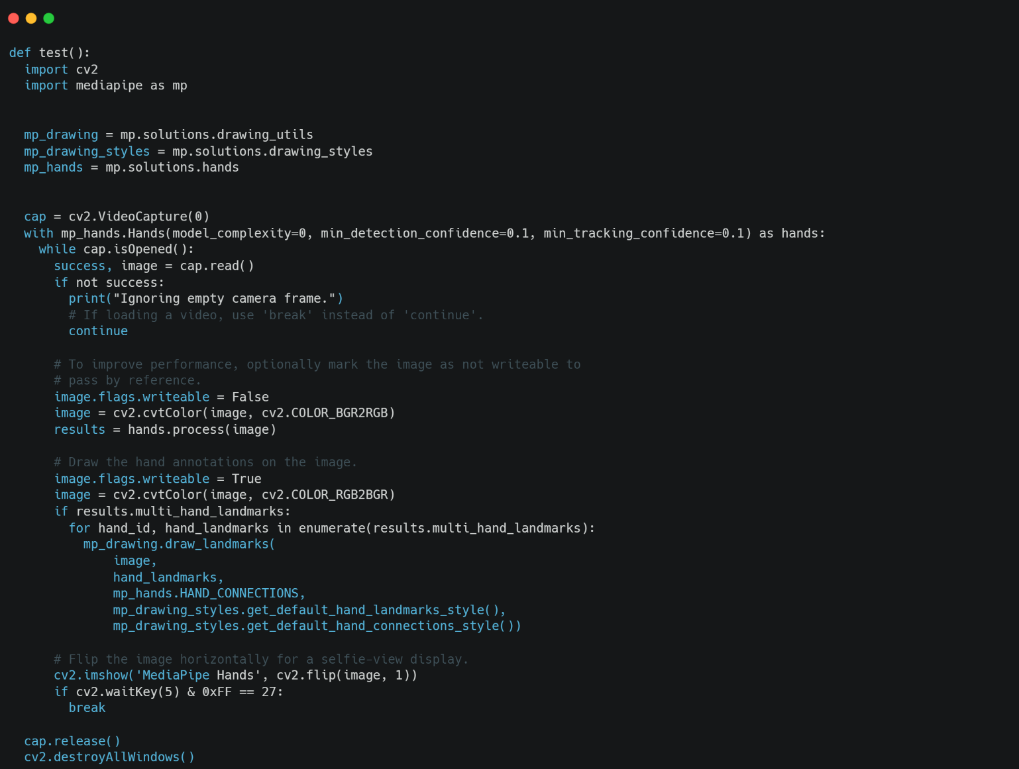
Landmark implementation:
This module uses MediaPipe to show landmarks of the hands in real-time using the webcam.

Slide 18
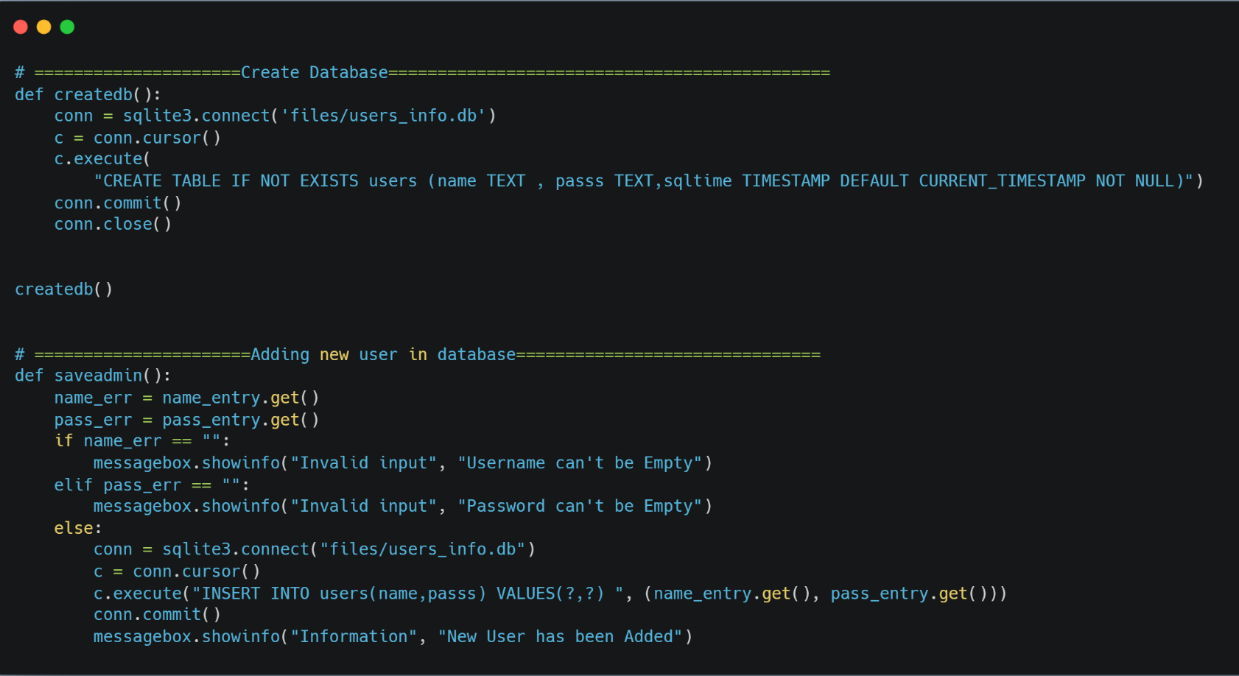
Database creation using SQLite:
This code shows the creation of database and how users are added into it.

Slide 19
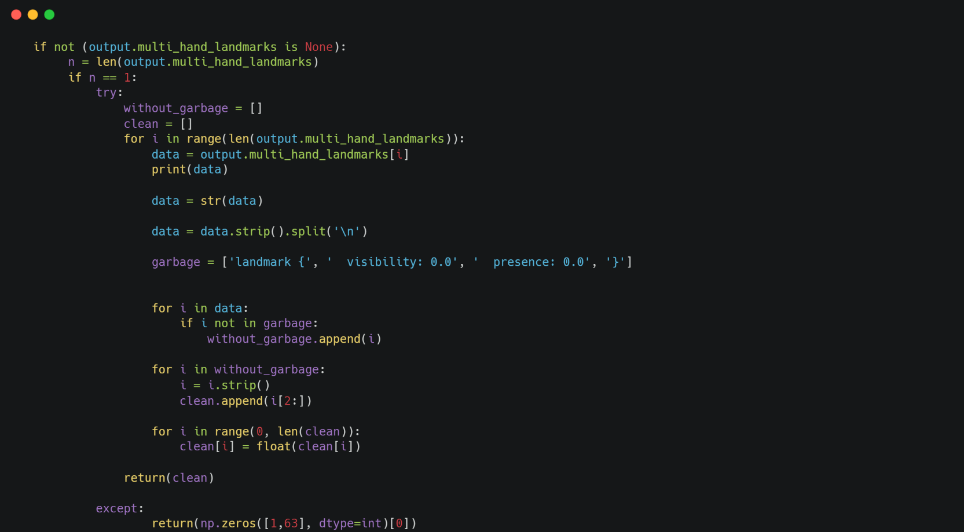
Data Collection for One Hand:
Takes the landmarks of one hand and arranges into an array.

Slide 20
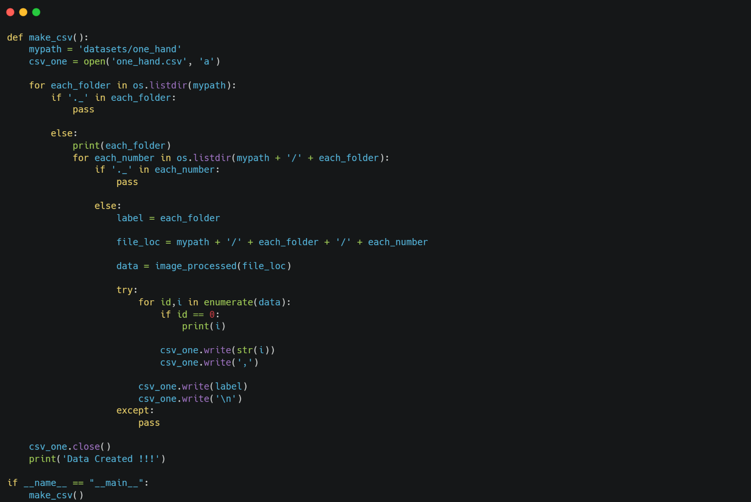
CSV file creation:
CSV file is created using the array of Landmark points.

Slide 21
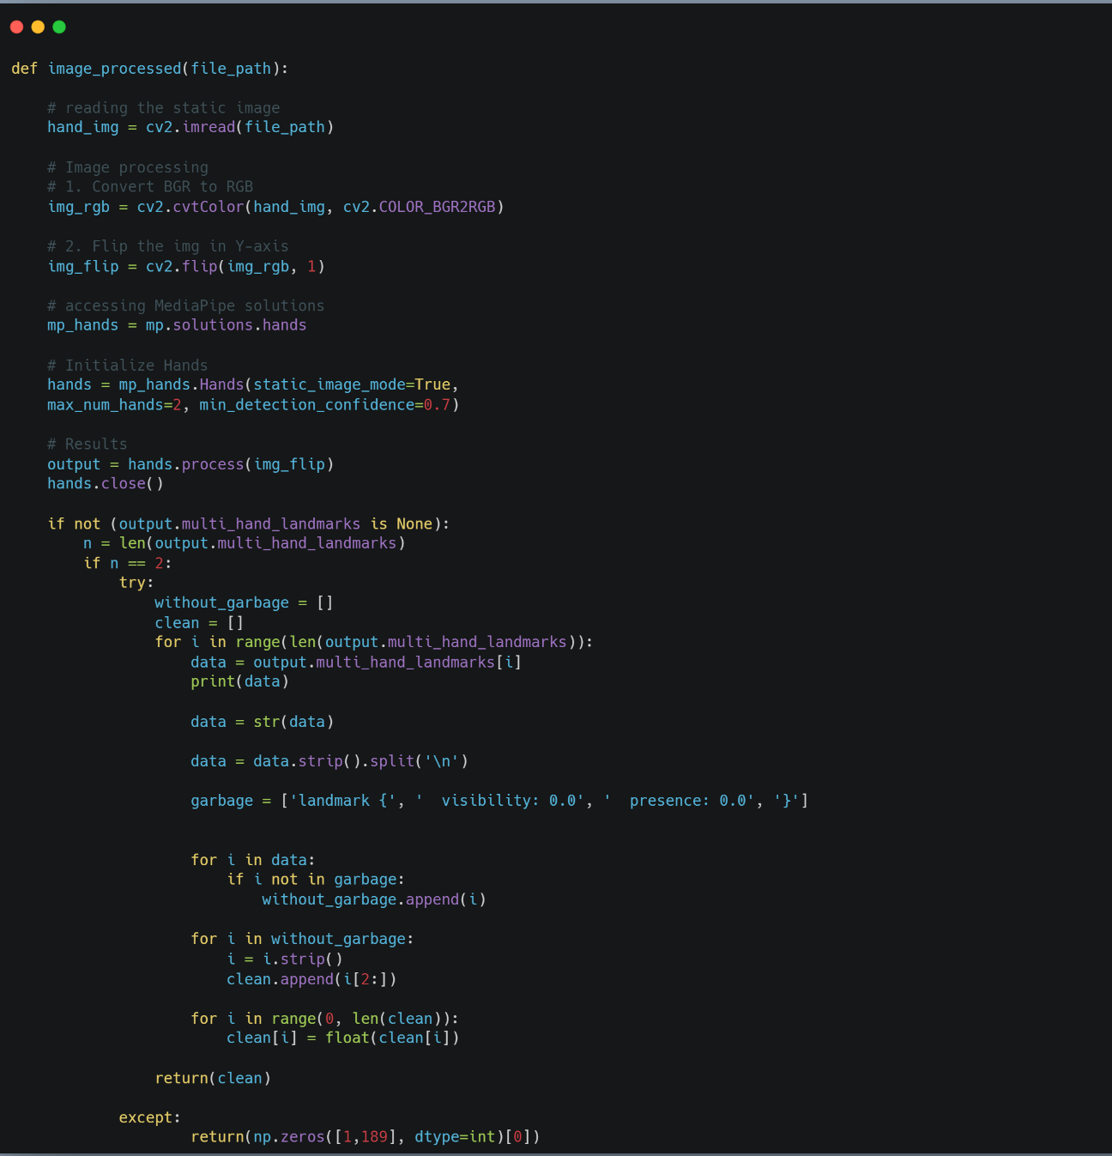
Data Collection for both Hands:
Takes the landmarks of both hands and arranges into an array.

Slide 22
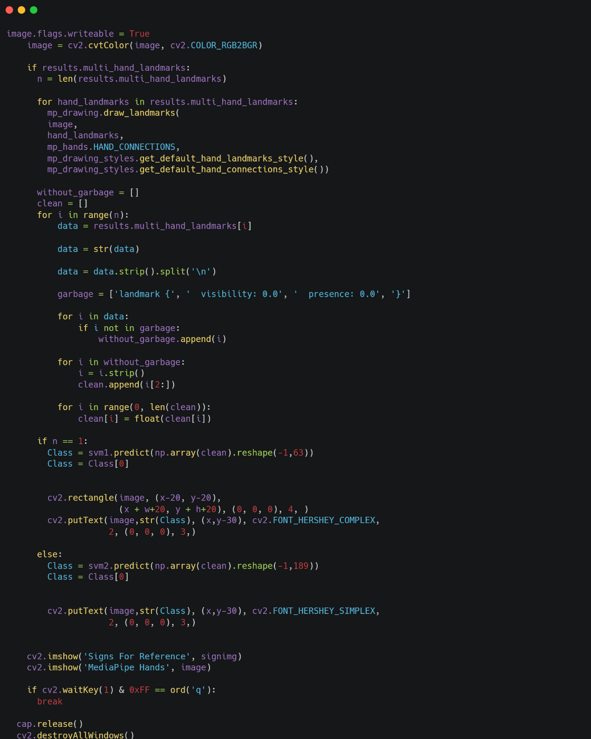
Hand recognition:
CSV values are compared and prediction is made using SVM classifier.

Slide 23
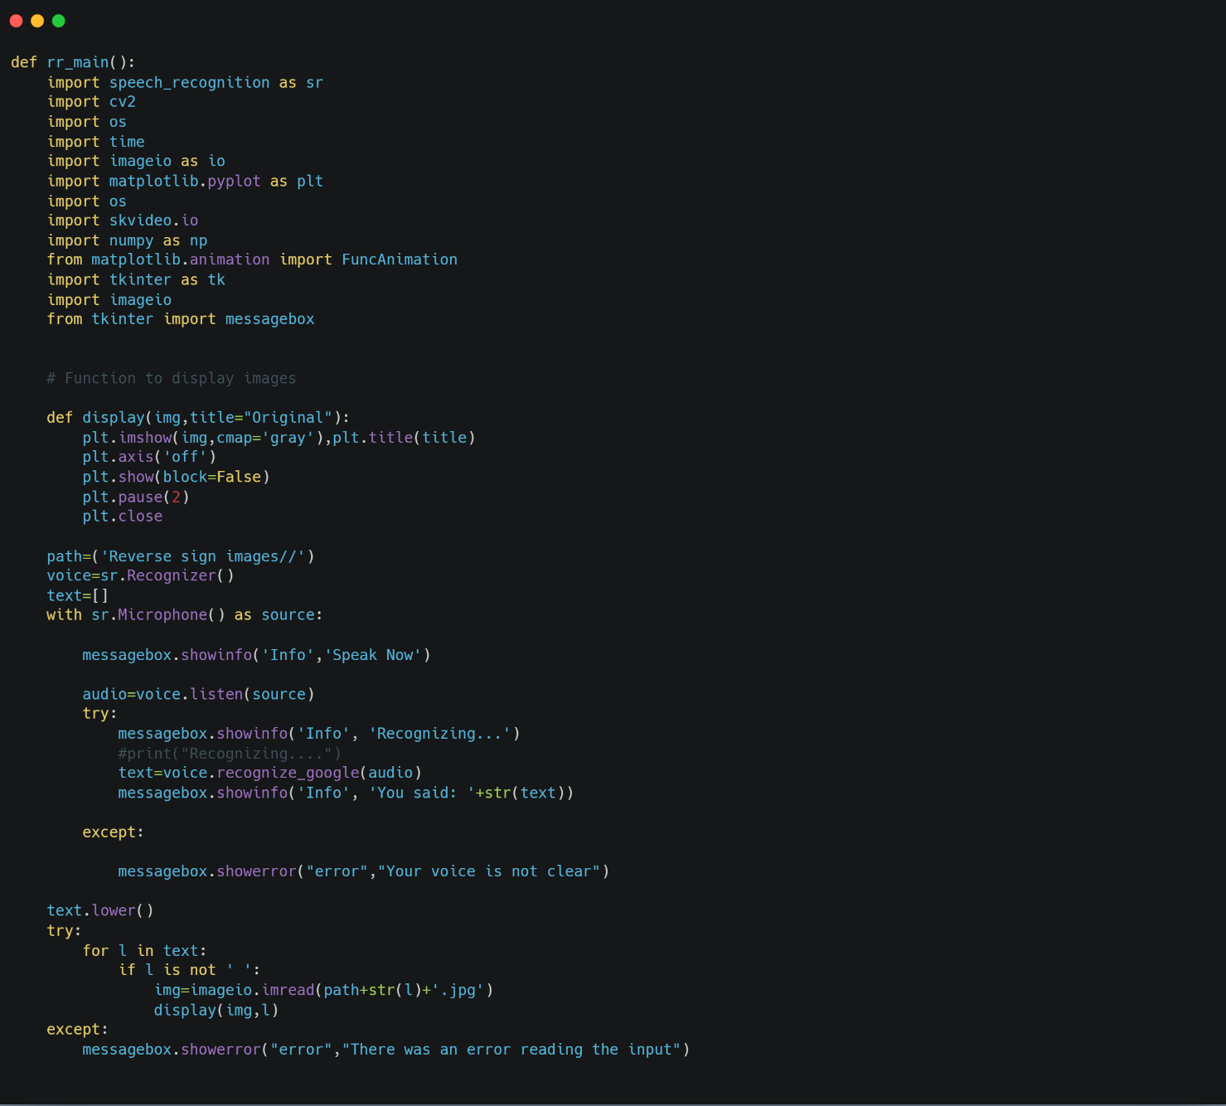
Voice to ISL:
Voice is converted to text using Google Recognizer.

Slide 24
Testing
Unit testing
Unit Testing is defined as a type of software testing where individual components of a software are tested.
Test Case no. | Description | Test Steps | Expected Result | Actual Result | Pass/Fail
1 | Signing up of users | Press the ‘Signup’ button and enter the details | Stores the given details in the database. | Successfully stored data in database. | Pass
2 | Logging in of users | Press the ‘Login’ button and enter the details | Checks for the given details in the database and logs in if matched | Successfully matched user in database and logged in. | Pass
 |  |  |  | User not found in database hence login failed | Pass

Slide 25
Test Case no. | Description | Test Steps | Expected Result | Actual Result | Pass/Fail
3 | Sign prediction | Press the ‘Predict Sign’ button and show the signs | Predicts the signs made by the user and must output the appropriate letter. | Successfully predicts the sign and outputs the appropriate letter. | Pass
4 | Landmark of the hands | Press the ‘Show Landmarks’ button and display hands. | Shows the Landmark points on the hands in real time. | Successfully shows Landmark points. | Pass
5 | Voice recognition of users | Press the ‘Sound Recognition’ button and start talking after the prompt. | Voice of the user must be recognized and converted into appropriate text and display the corresponding signs. | Successfully displays the accurate signs for the recognized speech. | Pass

Slide 26
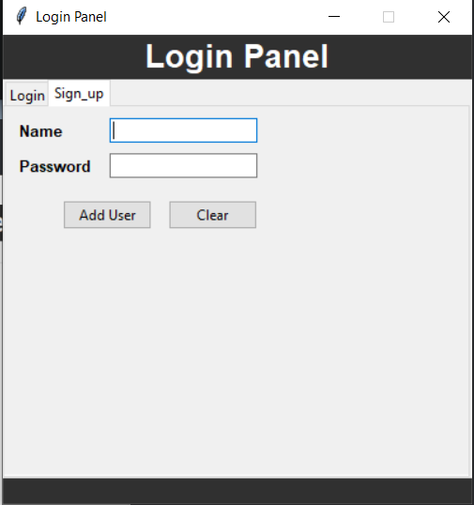
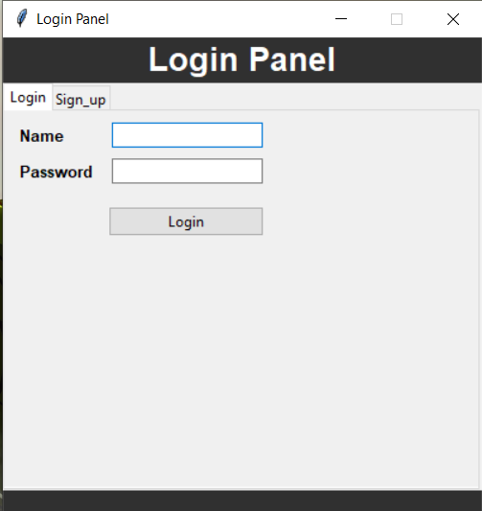
Discussion of Results
Sign-up Panel
Login Panel

Slide 27
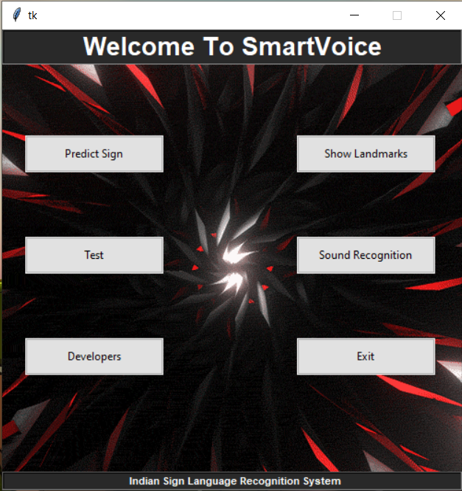
Interface

Slide 28
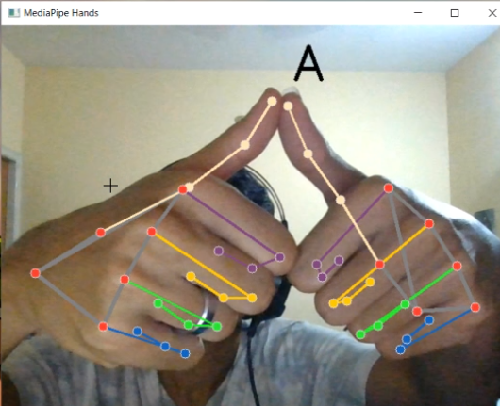
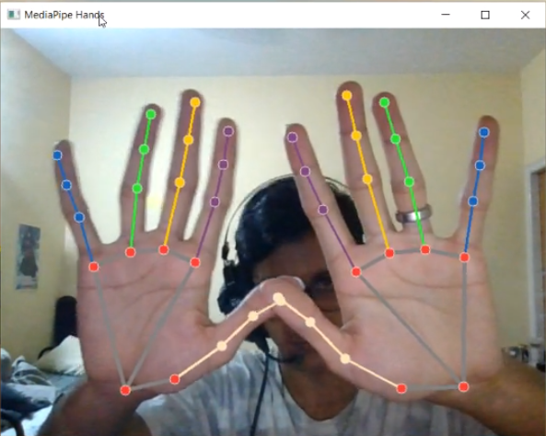
Recognition of letter ‘A’
Landmark Mapping

Slide 29
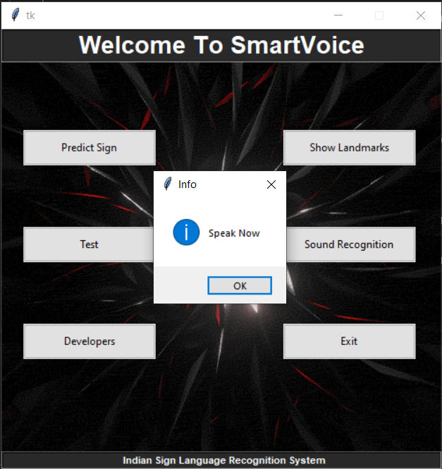
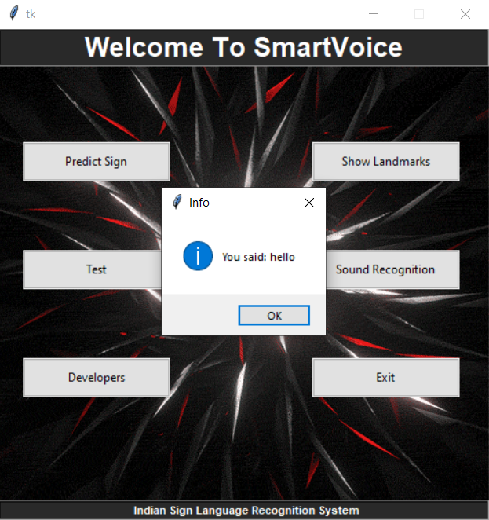
Sound Recognition
Sound Recognition successful

Slide 30
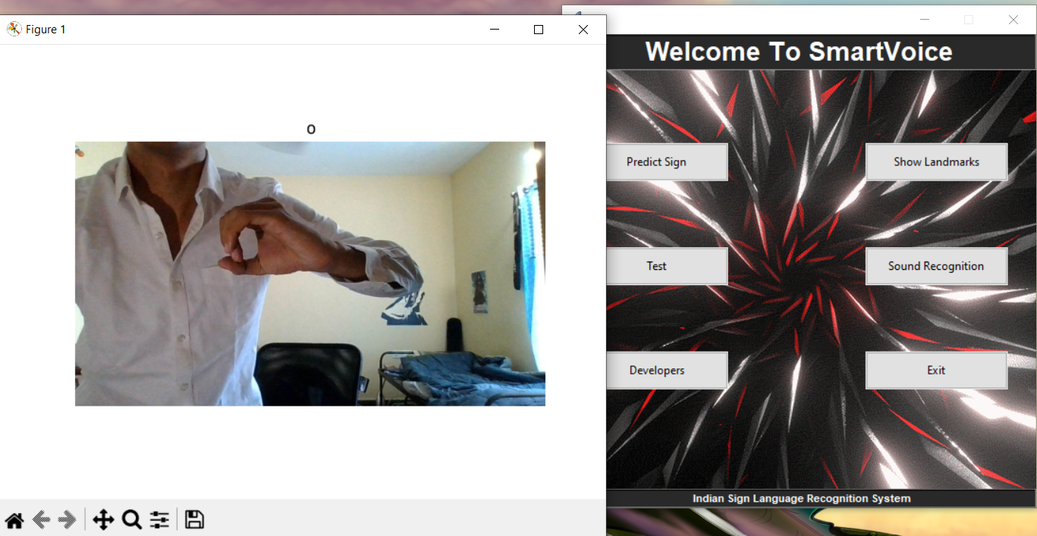
ISL representation of detected speech

Slide 31
National Conference Paper
Click here to view the National Conference paper

Slide 32
Conclusions
A real-time sign language identification system has been developed with improved feature extraction and GUI model
It uses SVM to classify the signs and give appropriate text as output
It has practical adaptation for blind/visually impaired people and uses hand gesture to text conversion, aiming to provide a summary without considering the signer

Slide 33
Future enhancements
For future development, it will require further research in advanced mathematical methods in image processing
This includes new detection algorithms from a mathematical point of view and methods to calculate lighting offsets and adjustments based on the user operating environment
Additional research and investments into hardware components such as infra-red cameras or two side-by-side webcams will also help to solve the problem
Implementing text-to-speech in regional languages

Slide 34
References
[1] Sunitha K. A, Anitha Saraswathi.P, Aarthi.M, Jayapriya. K, Lingam Sunny, “Deaf Mute Communication Interpreter- A Review”, International Journal of Applied Engineering Research, Volume 11, pp 290-296, 2016.
[2] Mathavan Suresh Anand, Nagarajan Mohan Kumar, Angappan Kumaresan, “ An Efficient Framework for Indian Sign Language Recognition Using Wavelet Transform” Circuits and Systems, Volume 7, pp 1874-1883, 2016.
[3] Mandeep Kaur Ahuja, Amardeep Singh, “Hand Gesture Recognition Using PCA”, International Journal of Computer Science Engineering and Technology (IJCSET), Volume 5, Issue 7, pp. 267-27, July 2015.
[4] Sagar P.More, Prof. Abdul Sattar, “Hand gesture recognition system for dumb people”.
[5] International Journal of Science and Research (IJSR).
[6] Chandandeep Kaur, Nivit Gill, “An Automated System for Indian Sign Language Recognition”, International Journal of Advanced Research in Computer Science and Software Engineering.

Slide 35
References
[7] Pratibha Pandey, Vinay Jain, “Hand Gesture Recognition for Sign Language Recognition: A Review”, International Journal of Science, Engineering and Technology Research (IJSETR), Volume 4, Issue 3, March 2015.
[8] Nakul Nagpal,Dr. Arun Mitra., Dr. Pankaj Agrawal, “Design Issue and Proposed Implementation of Communication Aid for Deaf & Dumb People”, International Journal on Recent and Innovation Trends in Computing and Communication ,Volume: 3 Issue: 5,pp- 147 – 149.
[9] Neelam K. Gilorkar, Manisha M. Ingle, “Real Time Detection And Recognition Of Indian And American Sign Language Using Sift”, International Journal of Electronics and Communication Engineering & Technology (IJECET), Volume 5, Issue 5, pp. 11-18 , May 2014.
[10] Neelam K. Gilorkar, Manisha M. Ingle, “A Review on Feature Extraction for Indian and American Sign Language”, International Journal of Computer Science and Information Technologies, Volume 5 (1) , pp314- 318, 2014.

Slide 36
References
[11] Ashish Sethi, Hemanth ,Kuldeep Kumar, Bhaskara Rao ,Krishnan R, “Sign Pro-An Application Suite for Deaf and Dumb”, IJCSET , Volume 2, Issue 5, pp-1203-1206, May 2012.
[12] Priyanka Sharma, “Offline Signature Verification Using Surf Feature Extraction and Neural Networks Approach”, International Journal of Computer Science and Information Technologies, Volume 5 (3) , pp 3539-3541, 2014.

Slide 37
Question and Answer

Slide 38
Thank You.

